Slide 1

Lecture 08 – RNNs and LSTMs
Baojian Zhou
DATA130030.01 (自然语言处理)
School of Data Science Fudan University
04/26/2023
Notes:
序列标注，词性标注和命名实体识别。

Slide 2
Outline
Language Models

Slide 3

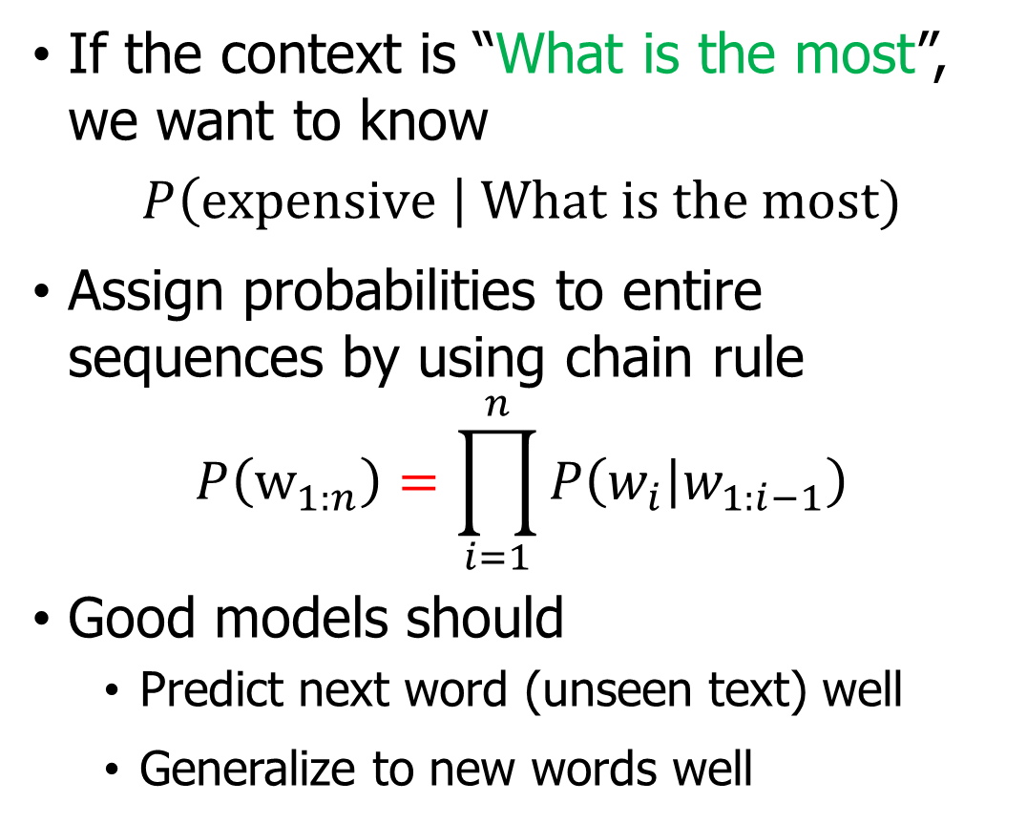
Language Models (LMs)
If the context is “What is the most”, we want to know
$$P\left(expensive \right| What is the most)$$
Assign probabilities to entire sequences by using chain rule
$$P\left(w_{1:n}\right)=\prod_{i=1}^{n}{P\left(w_{i} | w_{1:i−1}\right)}$$
Good models should
Predict next word (unseen text) well
Generalize to new words well
Notes:
在本章中，我们将通过概率语言模型的视角开始探索 RNN 和 Transformer 架构，所以让我们简要地提醒自己语言建模的框架。
回想一下第 3 章，概率语言模型在给定一些先前上下文的情况下预测序列中的下一个单词。 例如，如果前面的上下文是“Thanks for all the”，我们想知道下一个词是“fish”的可能性有多大，我们将计算：
语言模型使我们能够将这样的条件概率分配给每个可能的下一个单词，从而为我们提供整个词汇表的分布。 我们还可以通过将这些条件概率与链式规则结合使用来为整个序列分配概率

Slide 4
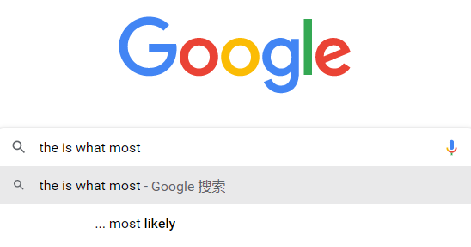
The order of the context is crucial
What is the most
v.s. the is what most

Slide 5
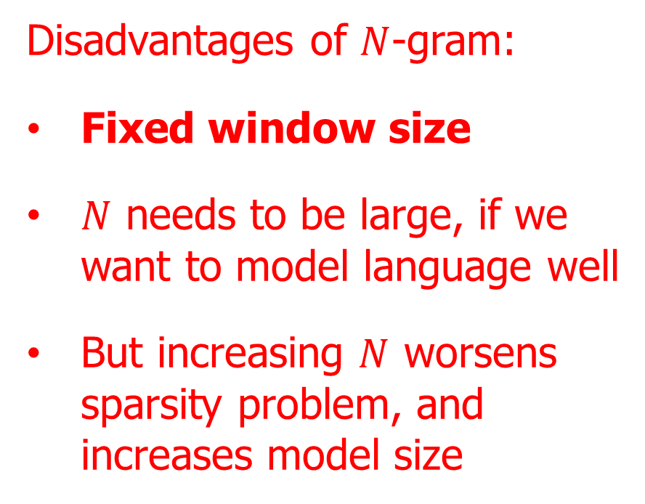
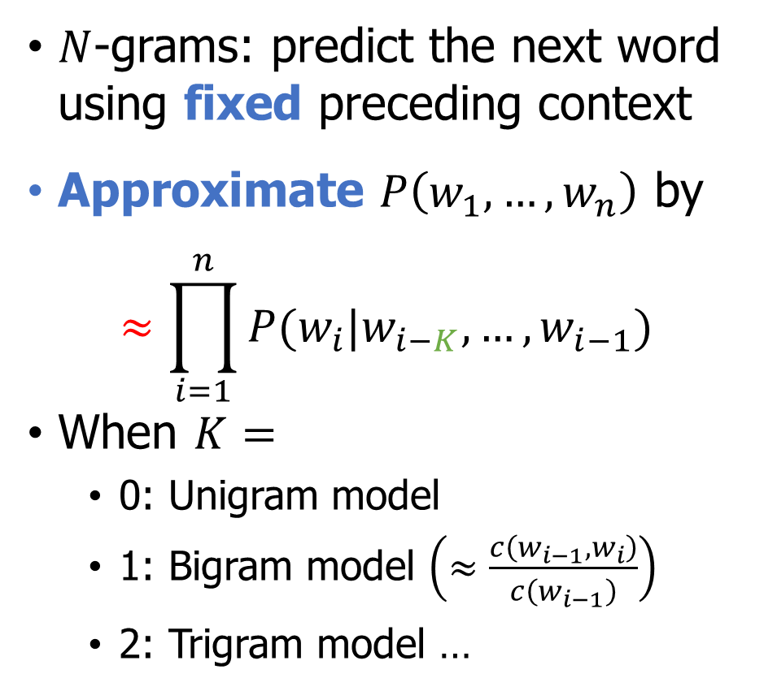
Naïve solution: $N$-gram language model
$N$-grams: predict the next word using fixed preceding context
Approximate $P\left(w_{1},…,w_{n}\right)$ by
$$≈\prod_{i=1}^{n}{P(w_{i}|w_{i−K}, …,w_{i−1})}$$
When $K=$
0: Unigram model
1: Bigram model $\left(≈\frac{c\left(w_{i−1},w_{i}\right)}{c\left(w_{i−1}\right)}\right)$
2: Trigram model …
Disadvantages of $N$-gram:
Fixed window size
$N$ needs to be large, if we want to model language well
But increasing $N$ worsens sparsity problem, and increases model size
Notes:
缺点1：对新词泛化性能不好
缺点2：目标函数进行了近似，不能很好的学习到

Slide 6
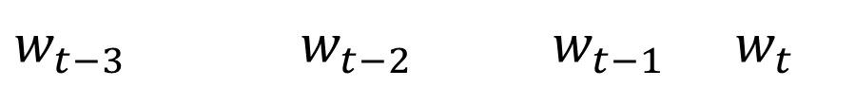
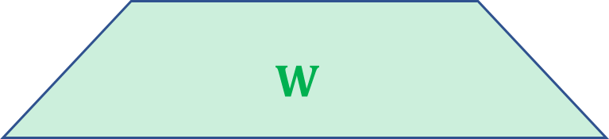
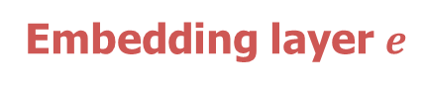

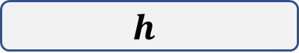
Better way: Feedforward neural LMs
$$p(ant|…) p(doe|…) p(fish|…) p(viewed|…)$$
Output layer
Good: No sparsity issue
Bad: Fixed context window, model will lose long dependence information
… … …
$$U$$
Hidden layer
$$h$$
$$W$$
How can we design LMs more effectively?
Predict
Embedding layer $e$
 | and | What | is | the | most | ?
$w_{t−3}$ $w_{t−2}$ $w_{t−1}$ $w_{t}$

Slide 7
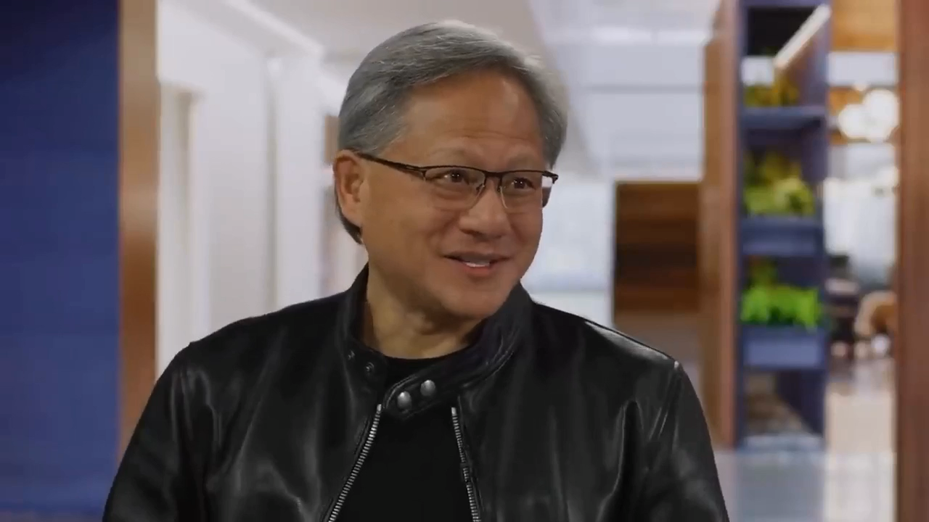
Currently best: Language Model (GPT-4)
Accurately predict next word is super important!
Notes:
What were the major differences between ChatGPT and GPT4 that led to its improvements in these in these areas?
Perhaps the most important difference is that the base on top of GPT4 is built predicts the next word with crater accuracy this is really important
because the better a neural network can predict the next word in text the more it understands it. This claim is now perhaps accepted by many at this point but it might still not be intuitive or not completely intuitive as to why there is. So I'd like to take a small detour and to give an analogy that will hopefully clarify why more accurate prediction of the next word leads to more understanding real understanding. Let's consider an example say you read a detective novel it's like a complicated plot a storyline different characters lots of events Mysteries like Clues it's unclear then let's say that at the last page of the book the detective has gathered all the clues gathered all the people and saying. okay I'm going to reveal the identity of whoever committed the crime and that person's name is predict that word predict that word exactly my goodness right yeah right now. there are many different words but by predicting those words better and better and better the understanding of the text keeps on increasing gpt4 predicts the next word better.

Slide 8
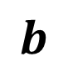

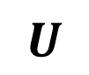
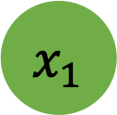
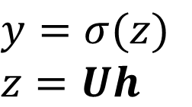
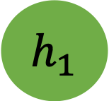
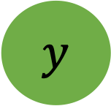
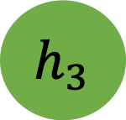
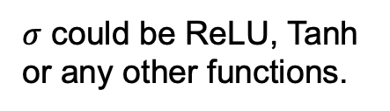
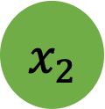
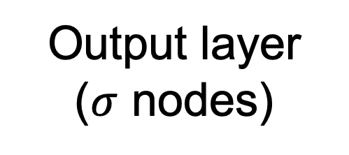
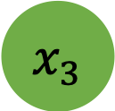
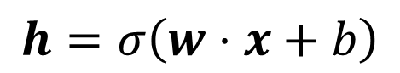
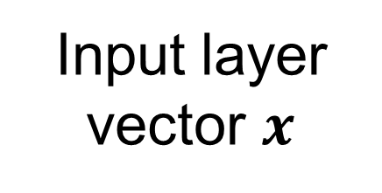
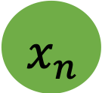
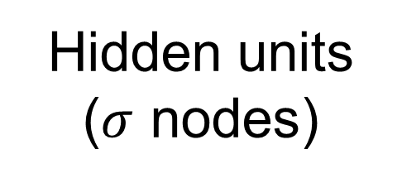
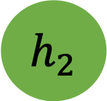
FNNs for Language Models
Output layer
($σ$ nodes)
$$y$$
$y=σ(z)$
$z=Uh$
$$U$$
Hidden units
($σ$ nodes)
$$h_{1}$$
$$h_{2}$$
$$h_{3}$$
$$h=σ\left(w⋅x+b\right)$$
$σ$ could be ReLU, Tanh or any other functions.
$$W$$
$$b$$
Fixed context window size for LMs
Input layer
vector $x$
$$x_{1}$$
$$x_{2}$$
$$x_{3}$$
$$x_{n}$$
+1

Slide 9
Small and Fixed window size is problematic
Short dependencies
The cat chased the ______.
She quickly grabbed her ________ because it started to rain.
Long dependencies
Although he had been studying for weeks and felt well-prepared for the important exam, a sudden illness the night before caused him to ____ the opportunity.
The ancient artifact, which had been hidden for centuries in the remote cave and was only discovered last year by a group of adventurous archaeologists, will finally be ________ in the museum.
mouse
umbrella
miss
displayed
We need a neural architecture that can process any length input!
Notes:
In this sentence, the long dependency is between "studying" and "miss." The cause (studying and feeling well-prepared) is distant from the effect (missing the opportunity), making it a long dependency.
The long dependency in this sentence connects "artifact" and "displayed." The sentence provides additional information about the artifact, which interrupts the primary subject-action-object relationship.

Slide 10
Outline
Language Models
Recurrent Neural Networks (RNNs)

Slide 11
Sequence Modeling Problems – 1 to 1
“Feedforward” Neural Networks
1 to 1

Slide 12
Sequence Modeling Problems – 1 to many
Image Captioning: Image -> sequence of words
1 to 1
1 to many

Slide 13
Sequence Modeling Problems – many to 1
Sentiment classification: Sequence of words -> label
1 to 1
1 to many
Many to 1

Slide 14
Sequence Modeling – many to many
Machine Translation: Sequence of words -> Sequence of words
1 to 1
1 to many
Many to 1
Many to many

Slide 15
Sequence Modeling – many to many
POS Tagging: $X$ length of tokens -> $X$ length of taggers
1 to 1
1 to many
Many to 1
Many to many
Many to many
How to take a variable length sequence as input and then predict a variable length sequence as output?

Slide 16
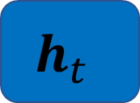
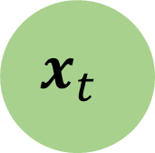
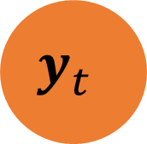
Simple RNNs
Simple RNN(Elman Network, 1990)
Hidden layer includes a recurrent connection (red circle) as part of its input
Activation value of the hidden layer depends on the current input + the activation value from the previous time step
Building blocks of more complex models such as Long Short-Term Memory (LSTM) and Gated Recurrent Units (GRU)
$$y_{t}$$
$$h_{t}$$
$$x_{t}$$

Slide 17
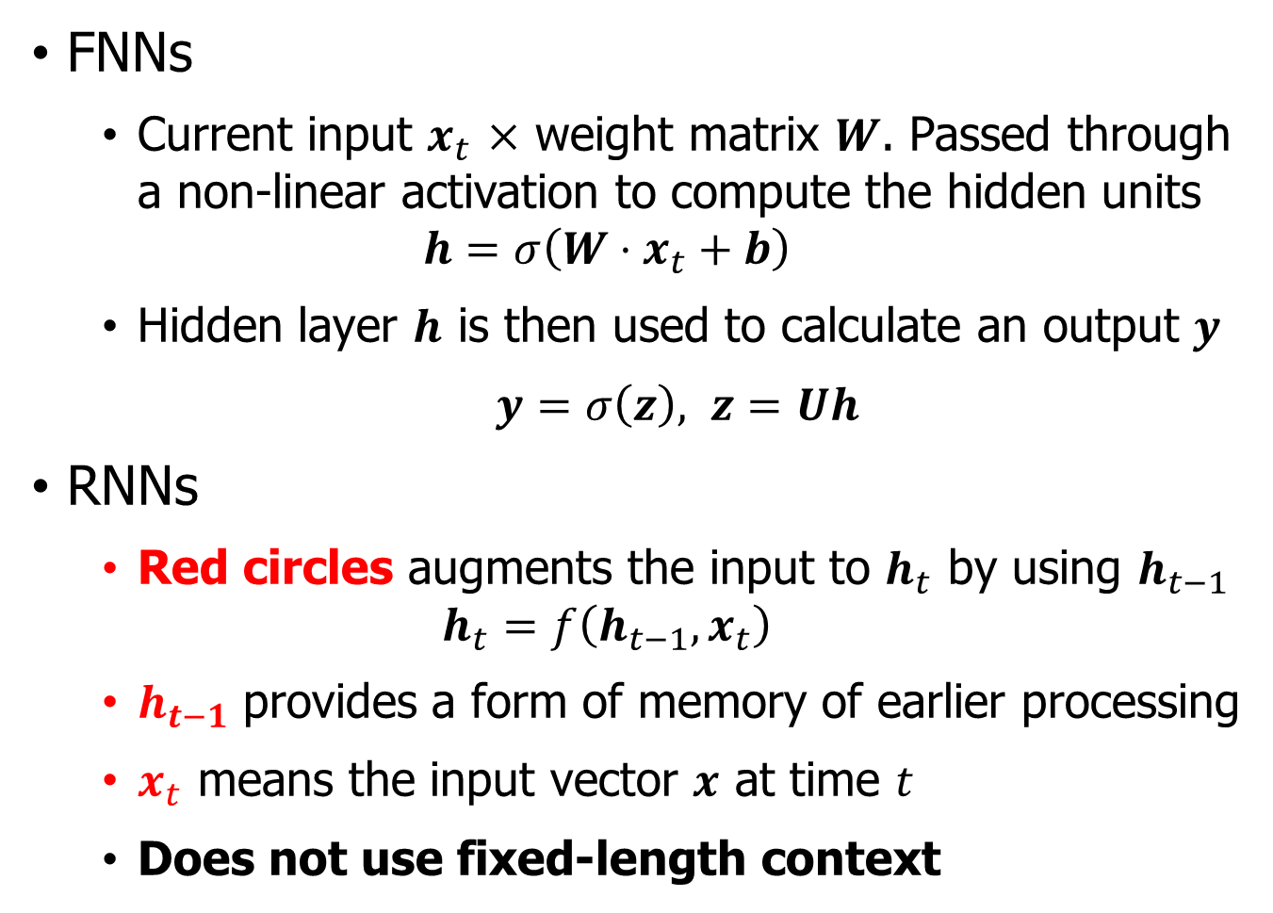

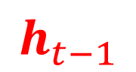
Simple RNNs v.s. FFNs
FNNs
Current input $x_{t}$ $×$ weight matrix $W$. Passed through a non-linear activation to compute the hidden units
$$h=σ\left(W⋅x_{t}+b\right)$$
Hidden layer $h$ is then used to calculate an output $y$
$y=σ\left(z\right), z=Uh$
RNNs
Red circles augments the input to $h_{t}$ by using $h_{t−1}$
$$h_{t}=f\left(h_{t−1},x_{t}\right)$$
$h_{t−1}$ provides a form of memory of earlier processing
$x_{t}$ means the input vector $x$ at time $t$
Does not use fixed-length context
$$y_{t}$$
$$h_{t}$$
$$h_{t−1}$$
$$x_{t}$$
How to design model weight?

Slide 18

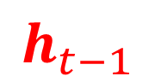


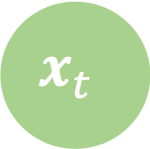
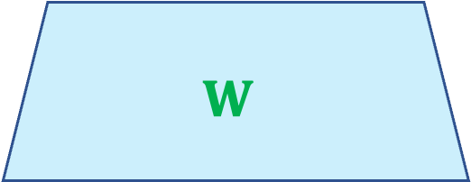

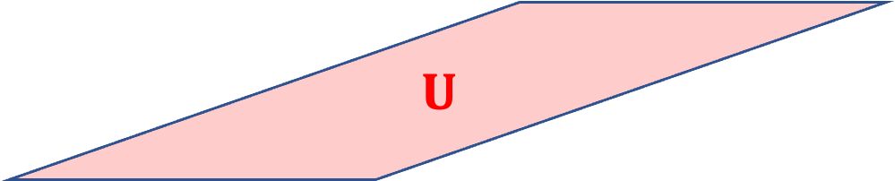

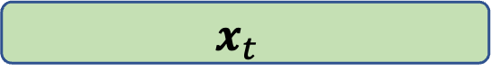


RNN inference as an FNN
$U$: connects $h_{t−1}$to the current hidden layer $h_{t}$
RNN inference as an FNN
$$y_{t}$$
$$y_{t}$$
$$h_{t}$$
$$V$$
Hidden layer from the previous time step
$$h_{t}$$
$$h_{t}$$
$$U$$
$$h_{t−1}$$
$$W$$
$$x_{t}$$
$$h_{t−1}$$
$$x_{t}$$

Slide 19
Properties of RNNs
FNNs accept a fixed-sized vector as input (e.g., word embeddings) and produce a fixed-sized vector as output (softmax probabilities)
RNNs allow us to operate over sequences of vectors: Sequences in the input, the output, or in the most general case both.
1 to 1
1 to many
Many to 1
Many to many
Many to many

Slide 20

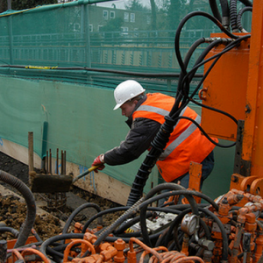
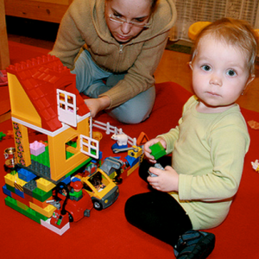
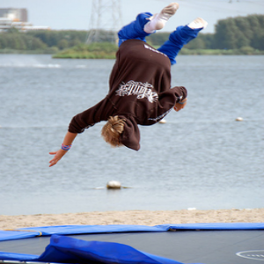
Successful RNNs – One to many
Multimodal Recurrent Neural Network architecture generates sentence descriptions from images
Input Image
Language descriptions
Man in black shirt is playing guitar
Construction worker in orange safety vest is working on road
Two young girls are playing with lego toy
Boy is doing backflip on wakeboard
Karpathy Andrej, and Li Fei-Fei. "Deep visual-semantic alignments for generating image descriptions." CVPR, 2015.

Slide 21
Successful RNNs – Many to One
Classification: Recursive Neural Tensor Network is proposed and outperforms all previous methods on the new treebank dataset.
What really surprises about Wisegirls is its low-key quality and genuine tenderness.
Inherently caustic and oddly whimsical, the film chimes in on the grieving process and strangely draws the audience into the unexplainable pain and eccentricities that are attached to the concept of loss.
It dares to be a little different , and that shading is what makes it worthwhile.
Input Reviews
Output label
(0.952) very positive
0.0139 (very negative)
0.798 (positive)
[0, 0.2] | (0.2, 0.4] | (0.4, 0.6] | (0.6, 0.8] | (0.8, 1.0]
very negative | negative | neutral | positive | very positive
Class labels
Socher, Richard, et al. “Recursive deep models for semantic compositionality over a sentiment treebank.” EMNLP, 2013.

Slide 22
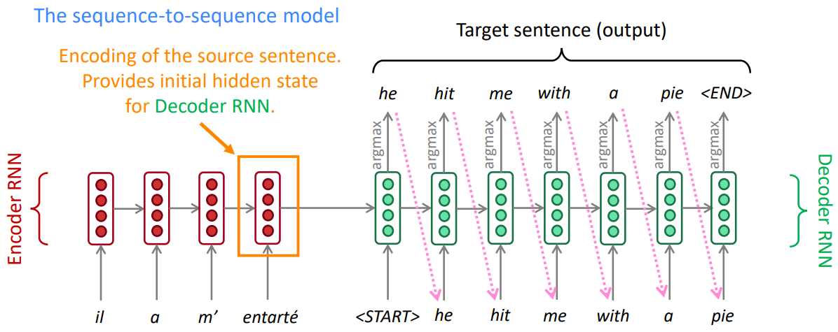
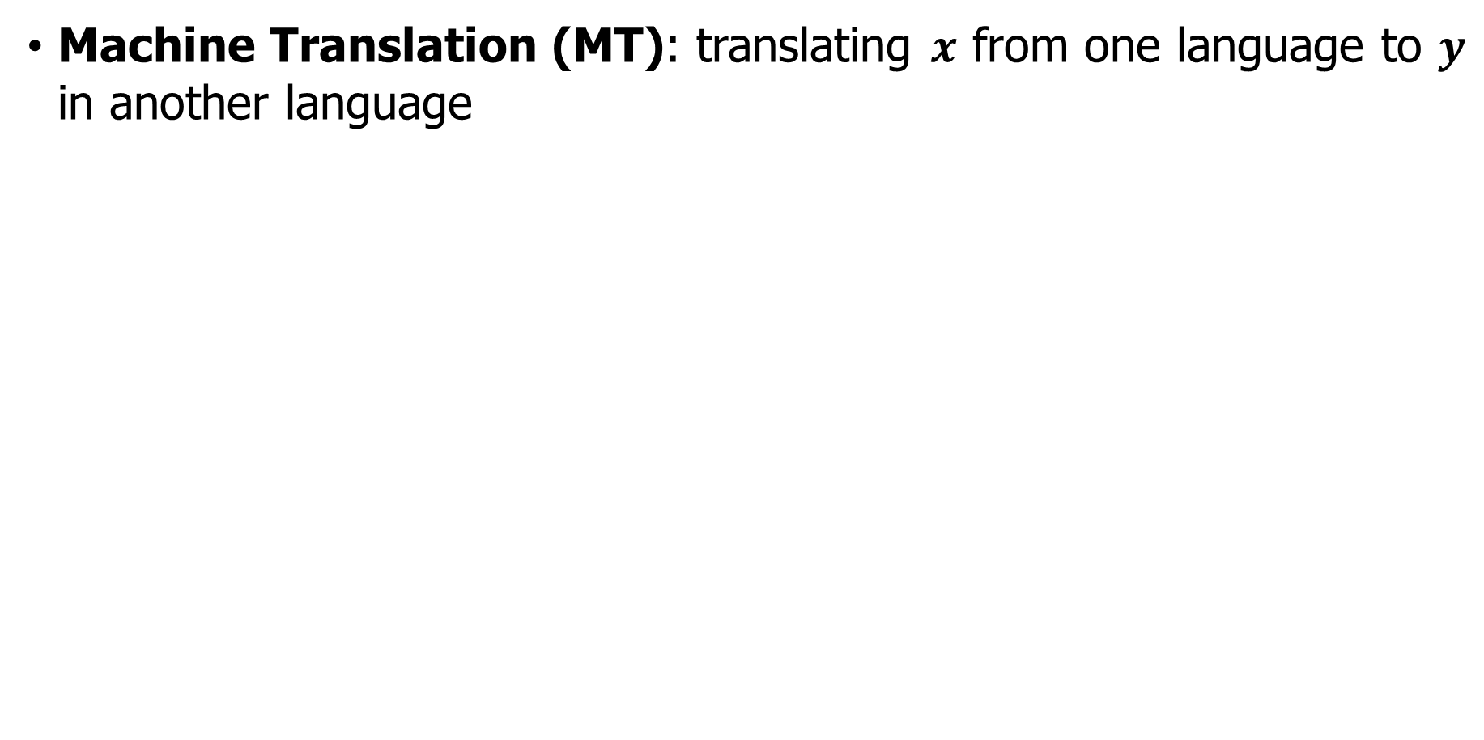
Successful RNNs – Many to Many
Machine Translation (MT): translating $x$ from one language to $y$ in another language
French
$x$: L'homme est né libre, et partout il est dans les fers
$y$: Man is born free, but everywhere he is in chains
Many to many
https://web.stanford.edu/class/cs224n/slides/cs224n-2019-lecture06-rnnlm.pdf

Slide 23
Outline
Review of LM and FFN
Recurrent Neural Networks (RNNs)
Inference of RNNs

Slide 24

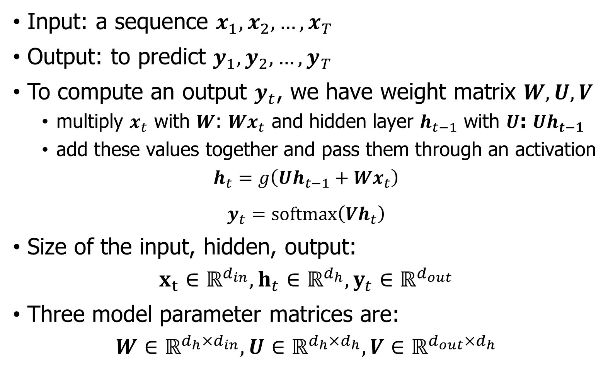

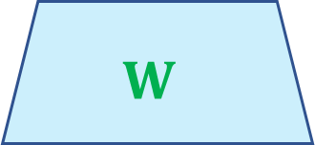
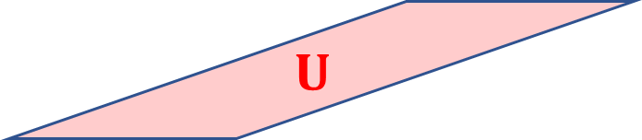
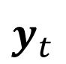


Inference in vanilla RNNs
Input: a sequence $x_{1},x_{2},…,x_{T}$
Output: to predict $y_{1},y_{2},…,y_{T}$
To compute an output $y_{t}$, we have weight matrix $W,U,V$
multiply $x_{t}$ with $W$: $Wx_{t}$ and hidden layer $h_{t−1}$ with $U$: $Uh_{t−1}$
add these values together and pass them through an activation
$$h_{t}=g\left(Uh_{t−1}+Wx_{t}\right)$$
$y_{t}=softmax\left(Vh_{t}\right)$
Size of the input, hidden, output:
$$x_{t}∈ℝ^{d_{in}},h_{t}∈ℝ^{d_{h}},y_{t}∈ℝ^{d_{out}}$$
Three model parameter matrices are:
$$W∈ℝ^{d_{h}×d_{in}},U∈ℝ^{d_{h}×d_{h}},V∈ℝ^{d_{out}×d_{h}}$$
$$y_{t}$$
$$V$$
$$h_{t}$$
$$U$$
$$W$$
$$h_{t−1}$$
$$x_{t}$$

Slide 25
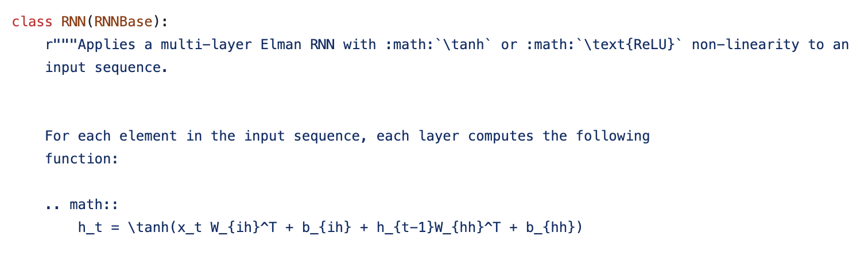
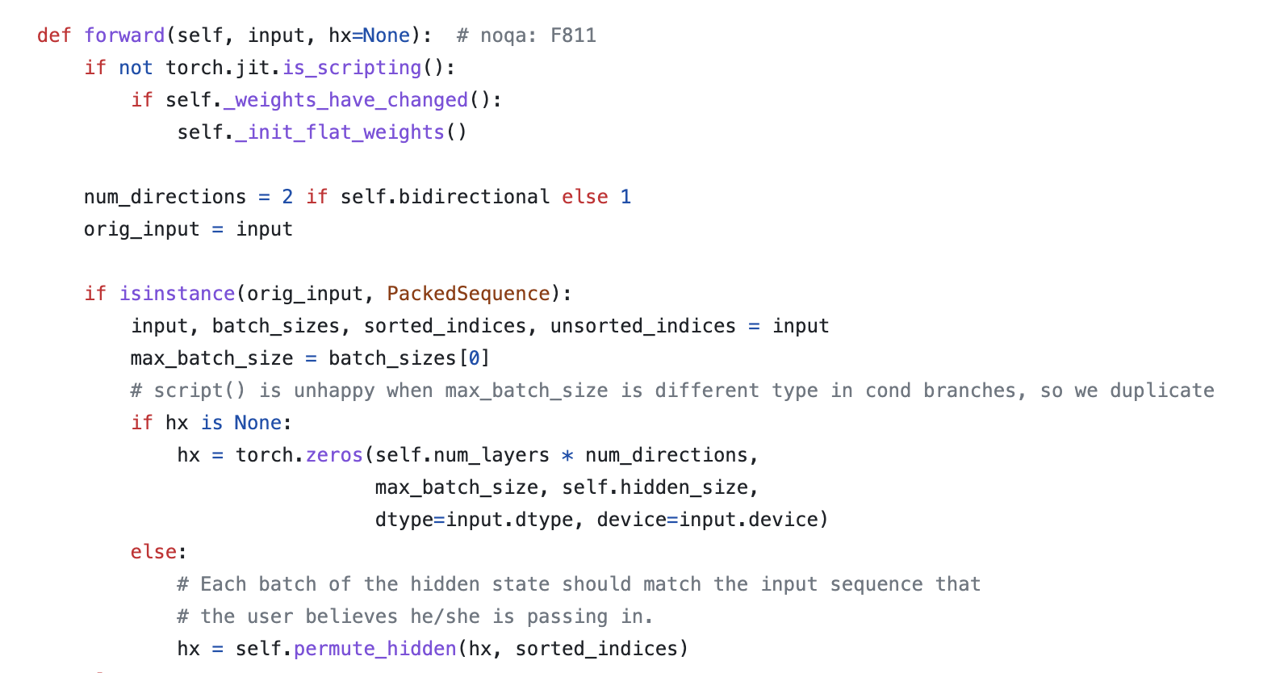
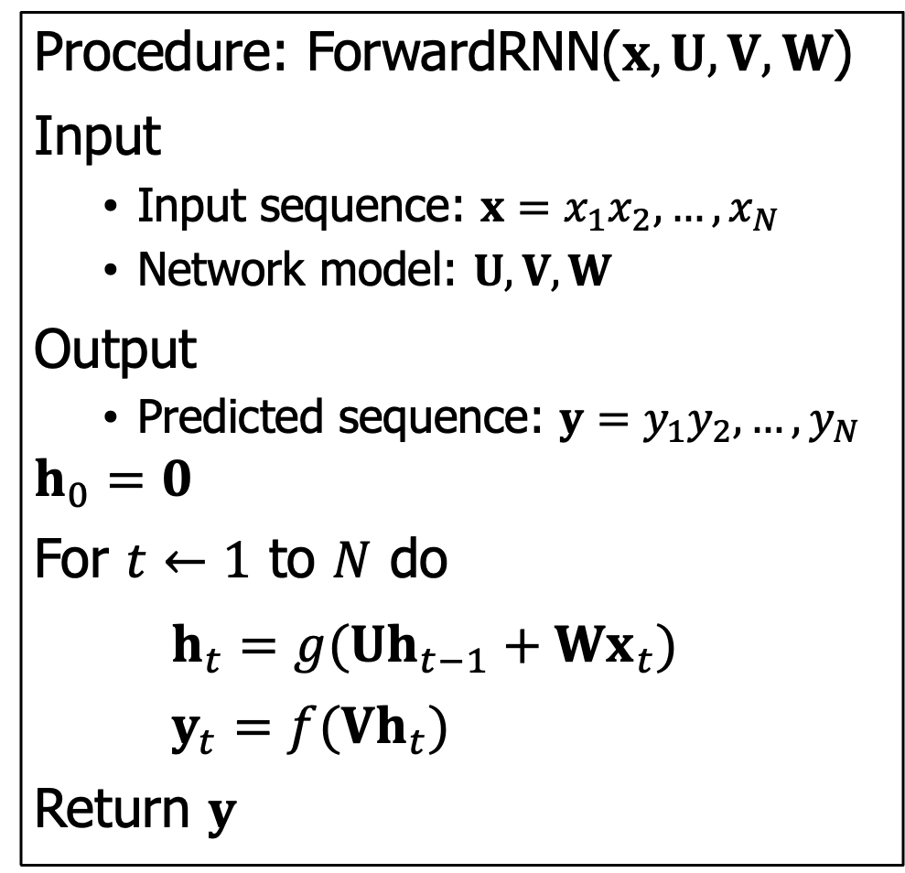
Inference in RNNs
Procedure: ForwardRNN($x,U,V,W$)
Input
Input sequence: $x=x_{1}x_{2},…,x_{N}$
Network model: $U,V,W$
Output
Predicted sequence: $y=y_{1}y_{2},…,y_{N}$
$$h_{0}=0$$
For $t←1$ to $N$ do
$h_{t}=g({Uh}_{t−1}+{Wx}_{t})$
$y_{t}=f(Vh_{t})$
Return $y$
Pytorch Implementation

Slide 26
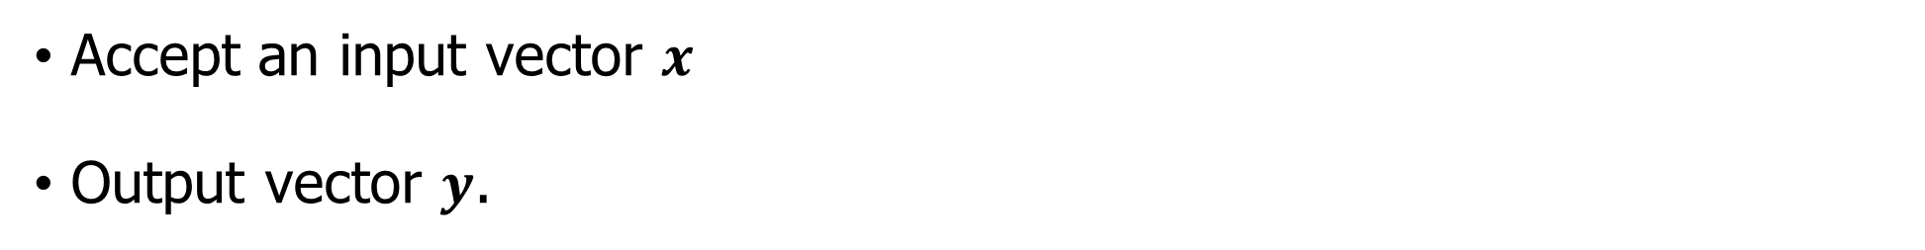
Inference: Simple Python computation
Accept an input vector $x$
Output vector $y$.
class RNN:
def inference(self, x):
# update the hidden state
self.h = np.tanh(np.dot(self.U_hh), self.h) + np.dot(self.W_xh,x))
# compute the output vector
y = np.dot(self.V_hy, self.h)
return y
rnn = RNN()
y=rnn.inference(x)

Slide 27
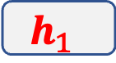
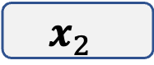




















RNN -- Inference as Unfolding
Unfolding the for loop
$$y$$
…
$$y_{3}$$
$$V$$
$$h_{3}$$
$$y_{2}$$
Unfolding
$$U$$
$$W$$
$$V$$
$$h$$
$$h_{2}$$
$$x_{3}$$
$$y_{1}$$
$$U$$
$$W$$
$$V$$
$$h_{1}$$
$$x_{2}$$
$$x$$
$$U$$
$$W$$
$$h_{0}$$
$$x_{1}$$

Slide 28

























RNN -- Inference as Unfolding
$$y$$
$$y_{t−2}$$
$$y_{t−1}$$
$$y_{t}$$
$$y_{t+1}$$
$$V$$
$$V$$
$$V$$
$$V$$
Unfolding
$$h_{t−2}$$
$$U$$
$$h_{t−1}$$
$$U$$
$$h_{t}$$
$$U$$
$$h_{t+1}$$
$$U$$
$$h$$
$$W$$
$$W$$
$$W$$
$$W$$
$$x$$
$$x_{t−2}$$
$$x_{t−1}$$
$$x_{t}$$
$$x_{t+1}$$

Slide 29
Outline
Review of LM and FFN
Recurrent Neural Networks (RNNs)
Inference of RNNs
Character-Level LMs
RNNs as Language Models

Slide 30
Character-Level LMs
Given Vocabulary = {h, e, l, o} and training sequence: hello
Build an RNN model for character-level language models
Based on training sequence, we have 4 separate training examples
he: “e” should be likely given the context of “h”
hel: “l” should be likely in the context of “he”
hell: “l” should also be likely in the context of “hel”
hello: “o” should be likely given the context of “hell”

Slide 31













Character-Level LMs
Encode each character into a vector
Feed these input chars into RNN one at a time with “step” function
Observe a sequence of 4-dimensional output vectors
Target chars e l l o e
1.0
2.2
-3.0
4.1
0.5
0.3
-1.0
1.2
0.1
0.5
1.9
-1.1
0.2
-1.5
-0.1
2.2
0.7
1.2
-0.3
-1.6
Output Layer $y$
$$V$$
$$V$$
$$V$$
$$V$$
$$V$$
0.3
-0.1
0.9
$$U$$
1.0
0.3
0.1
$$U$$
0.1
-0.5
-0.3
$$U$$
-0.3
0.9
0.7
$$U$$
-0.3
0.9
0.7
Hidden Layer $h$
$$W$$
$$W$$
$$W$$
$$W$$
$$W$$
1
0
0
0
0
1
0
0
0
0
1
0
0
0
1
0
0
0
0
1
Input Layer $x$
Input chars h e l l o

Slide 32

Character-Level LMs
Input: 100MB dataset of raw Wikipedia
Model: multilayer LSTM
Sampled Wikipedia article:

Slide 33


Character-Level LMs
Input: all the source and header files found in the Linux repo on Github, concatenated all of them in a single file (474MB of C code)
Model: 3-layer LSTMs (10 million parameters)
Generated code:

Slide 34


Character-Level LMs
Input: the whole book on algebraic stacks/geometry, which is the raw Latex source file (a 16MB file)
Model: multilayer LSTM
Generated Latex code (after compilation)

Slide 35



RNNs as Language Models
Text
Model
The Sonnets – Shakespeare
From fairest creatures we desire increase, That thereby beauty's rose might never die, But as the riper should by time decease, His tender heir might bear his memory: ….
When forty winters shall beseige thy brow, And dig deep trenches in thy beauty's field, Thy youth's proud livery, so gazed on now, Will be a tatter'd weed, of small worth held: Then being ask'd where all thy beauty lies, …
$$y_{t}$$
RNN($h_{t}$)
$$x_{t}$$

Slide 36

RNN language models
Input sequence $X = \left[x_{1};…;x_{t};…;x_{N}\right]$
A series of word embeddings each is a one-hot vector with size $|V|×1$
Output prediction $y$
Vector representing a probability distribution over the vocabulary
At each time $t$:
$e_{t}=Ex_{t}$
$h_{t}=g\left({Uh}_{t−1}+We_{t}\right)$
$y_{t}=softmax\left(Vh_{t}\right)$
$Vh_{t}$: scores over the vocabulary given the evidence provided in $h_{t}$
Probability of particular word $y_{t}\left[i\right]=P\left(w_{t+1}=i | w_{1},…,w_{t}\right)$

Slide 37

RNN language models - Loss
Probability of an entire sequence is just the product of the probabilities of each item in the sequence
$y_{t}\left[w_{i}\right]$: the probability of the true word $w_{i}$ at time step $i$.
The probability of an entire sequence:
$$P\left(w_{1:n}\right)=\prod_{i=1}^{n}{P\left(w_{i} | w_{1:i−1}\right)}=\prod_{t=1}^{n}{y_{t}\left[w_{i}\right]}$$
Use cross-entropy as the loss function
$$L_{CE}=−\sum_{w∈V}{y_{t}\left[w\right]\log{{\hat{y}}_{t}[w]}}$$

Slide 38

RNN language models - Loss
Use cross-entropy as the loss function
$$L_{CE}=−\sum_{w∈V}{y_{t}\left[w\right]\log{{\hat{y}}_{t}[w]}}$$
Correct distribution $y_{t}$ comes from knowing the next word. It is represented as a one-hot vector corresponding to $w_{t}$ where the entry for the actual next word is 1, and all the other entries are 0
CE loss at time $t$is the negative log probability the model assigns to the next word in the training sequence
$$L_{CE}({\hat{y}}_{t},y_{t})=−\log{{\hat{y}}_{t}\left[w_{t+1}\right]}$$

Slide 39









RNN language models – Loss & Training
Next word
long and thanks for all …
Loss$=\frac{1}{T}\sum_{t=1}^{T}{L_{CE}}$
$$−\log{y_{long}}$$
$$−\log{y_{and}}$$
$$−\log{y_{thanks}}$$
$$−\log{y_{for}}$$
$$−\log{y_{all}}$$
…
Softmax over $V$
$$V⋅h$$
RNN layer(s)
$$h$$
Embeddings
Input Words So long and thanks for …

Slide 40



Reduce redundancy
$Vh$: final layer matrix $V$ provides a way to score the likelihood of each word in the vocabulary given the evidence present in the final hidden layer of the network
Is it even necessary to have both $V$ and $E$? No.
Weight tying: a method that dispenses with this redundancy and simply uses a single set of embeddings at the input and softmax layers.
Advantages:
1) improved model perplexity;
2) significantly reduces the model size.
$e_{t}=Ex_{t}$
$h_{t}=g\left({Uh}_{t−1}+We_{t}\right)$
$y_{t}=softmax\left(Vh_{t}\right)$
$e_{t}=Ex_{t}$
$h_{t}=g\left({Uh}_{t−1}+We_{t}\right)$
$y_{t}=softmax\left(Eh_{t}\right)$

Slide 41
Outline
Review of LM and FFN
Recurrent Neural Networks (RNNs)
Inference of RNNs
Character-Level LMs
RNNs as Language Models
RNNs for other NLP tasks
Sequence labeling / Sequence classification / Text generation

Slide 42












RNNs – Sequence labeling
Assign labels to a sequence, like the POS tagging and NER tasks
RNN method: inputs are word embeddings and the outputs are tag probabilities generated by a softmax layer over the given tag set
Argmax
NNP MD VB DT NN
$$y_{1}$$
$$y_{2}$$
$$y_{3}$$
$$y_{4}$$
$$y_{5}$$
Softmax over tags
$$h$$
RNN layer(s)
Each $y_{i}$ is a softmax
Embeddings
$$e_{1}$$
$$e_{2}$$
$$e_{3}$$
$$e_{4}$$
$$e_{5}$$
Words Janet will back the bill

Slide 43

RNNs – Sequence classification
Classify entire sequences rather than the tokens within them
Examples
document-level topic classification
spam detection
sentiment classification …
Idea of applying RNNs
Pass the text through the RNN a word at a time
Take the hidden layer for the last token of the text $h_{n}$
Pass this representation $h_{n}$ to a feedforward network

Slide 44










RNNs – Sequence classification
Apply RNNs
Pass the text to be classified a word at a time generating a new hidden layer at each time step
Take the hidden layer for the last token of the text $h_{n}$
Pass this representation $h_{n}$ to a FNN that chooses a class via a softmax
$$Softmax$$
$$V$$
FFN
$$W$$
$$h_{n}$$
$$h_{n}$$
Vanilla RNN
$$x_{1}$$
$$x_{2}$$
$$x_{3}$$
$$x_{n}$$

Slide 45
RNNs – Sequence classification
Loss function is based on the final text classification task
The error signal from the classification is backpropagated all the way through the weights in the feedforward classifier to its input
End-to-end training: The training regimen that uses the loss from a downstream application to adjust the weights all the way through the network
$$Softmax$$
$$V$$
FFN
$$W$$
$$h_{n}$$
$$h_{n}$$
Vanilla RNN
$$x_{1}$$
$$x_{2}$$
$$x_{3}$$
$$x_{n}$$

Slide 46

RNNs – Sequence classification
Options of choosing hidden states
Just take the last hidden state $h_{n}$
Use some sort of pooling function
$$Softmax$$
$$V$$
FFN
$$W$$
$$h_{n}$$
$$h_{n}$$
Vanilla RNN
$$x_{1}$$
$$x_{2}$$
$$x_{3}$$
$$x_{n}$$

Slide 47













RNNs – Sequence classification
Options of choosing hidden states
Just take the last hidden state $h_{n}$
Use some sort of pooling function
Element-wise mean $h_{mean}=\frac{1}{n}\sum_{i=1}^{n}{h_{i}}$
Element-wise max
Other options.
$$Softmax$$
$$V$$
FFN
$$W$$
$$h_{mean}$$
$$mean pooling$$
$$h_{1}$$
$$h_{2}$$
$$h_{3}$$
$$h_{n}$$
Vanilla RNN
$$x_{1}$$
$$x_{2}$$
$$x_{3}$$
$$x_{n}$$

Slide 48
RNNs – Text generation
Examples of text generation
Question answering
Machine Translation
Text summarization
Chatbot
Autoregressive generation
Sample a word in the output from the softmax distribution that results from using the beginning of sentence marker, <s>, as the first input.
Use the word embedding for that first word as the input to the network at the next time step, and then sample the next word in the same fashion.
Continue generating until the end of sentence marker, </s>, is sampled or a fixed length limit is reached.

Slide 49
RNNs – Text generation
Autoregressive generation
Sampled word So long and ?
Softmax
RNN
Embedding
Input Word <s> So long and

Slide 50

RNNs – Text generation
Text generated of RNN-LM trained on Harry Potter:
“You believe if we’ve got friendly to come down and out of the library. I think I’ve found out Potter, I asked you he had . . . me. I think he’s not telling Dobby if yeh get with our Hogwarts …”
“Sorry,” Harry shouted, panicking — “I’ll leave those brooms in London, are they?”
https://medium.com/deep-writing/harry-potter-written-by-artificial-intelligence-8a9431803da6

Slide 51

RNNs – Text generation
Text generated of RNN-LM trained on recipes:
Title: CHOCOLATE RANCH BARBECUE
Categories: Game, Casseroles, Cookies, Cookies
Yield: 6 Servings
2 tb Parmesan cheese -- chopped
1 c Coconut milk
3 Eggs, beaten
Place each pasta over layers of lumps. Shape mixture into the moderate oven and simmer until firm. Serve hot in bodied fresh, mustard, orange and cheese.
Combine the cheese and salt together the dough in a large skillet; add the ingredients and stir in the chocolate and pepper.
Recipe By:
https://gist.github.com/nylki/1efbaa36635956d35bcc

Slide 52
Outline
Review of LM and FFN
Recurrent Neural Networks (RNNs)
Inference of RNNs
Character-Level LMs
RNNs as Language Models
RNNs for other NLP tasks
Sequence labeling / Sequence classification / Text generation
Stacking RNNs

Slide 53

RNN language models - Training
Input $X = \left[x_{1};…;x_{t};…;x_{N}\right]$ where $x_{i}$ is the embedding of word $i$
Output $Y = \left[y_{1};…;y_{t};…;y_{N}\right]$ where $y_{i}$ is probability distribution
Example:
$X=$ So long and thanks for …
$Y=$ long and thanks for …
Notes:
我们可以，

Slide 54




RNN language models - Training
Training RNNs as language models.
Next word
long and thanks for all …
Loss$=\frac{1}{T}\sum_{t=1}^{T}{L_{CE}}$
$$−\log{y_{long}}$$
$$−\log{y_{and}}$$
$$−\log{y_{thanks}}$$
$$−\log{y_{for}}$$
$$−\log{y_{all}}$$
…
Softmax over $V$
$$Vh$$
RNN layer(s)
$$h$$
Embeddings
Input Words So long and thanks for …
Notes:
这个单词级别的，含有句子级别的更新

Slide 55


































RNN - Training

Slide 56
























RNN - Training

Slide 57

























RNN - Training

Slide 58

































RNN - Training

Slide 59


























RNN - Training

Slide 60































RNN - Training

Slide 61































RNN – Training BPTT

Slide 62





























RNN – Training BPTT

Slide 63




















RNN – Training BPTT

Slide 64




















RNN – Training BPTT

Slide 65





























RNN – Training BPTT

Slide 66


























RNN – Training BPTT

Slide 67























RNN – Training BPTT

Slide 68
Multi-layer RNNs
RNNs are already “deep” on one dimension (they unroll over many timesteps)
We can also make them “deep” in another dimension by applying multiple RNNs – this is a multi-layer RNN.
This allows the network to compute more complex representations
Intuition: The lower RNNs should compute lower-level features and the higher RNNs should compute higher-level features.
Multi-layer RNNs are also called stacked RNNs.

Slide 69





















Multi-layer RNNs
Stacked RNNs: The hidden states from RNN layer $i$ are the inputs to RNN layer $i+1$.
$$y_{1}$$
$$y_{2}$$
$$y_{3}$$
$$y_{n}$$
$$h_{1}^{3}$$
$$h_{2}^{3}$$
$$h_{3}^{3}$$
$$h_{n}^{3}$$
higher-level features
RNN Layer 3
$$h_{1}^{2}$$
$$h_{2}^{2}$$
$$h_{3}^{2}$$
$$h_{n}^{2}$$
RNN Layer 2
$$h_{1}^{1}$$
$$h_{2}^{1}$$
$$h_{3}^{1}$$
$$h_{n}^{1}$$
lower-level features
RNN Layer 1
$$x_{1}$$
$$x_{2}$$
$$x_{3}$$
$$x_{n}$$

Slide 70

Multi-layer RNNs in practice
High-performing RNNs are often multi-layer (but aren’t as deep as convolutional or feed-forward networks).
Just like CNNs: the network induces representations at differing levels of abstraction across layers.
For example: In a 2017 paper, Britz et al find that for Neural Machine Translation, 2 to 4 layers is best for the encoder RNN, and 4 layers is best for the decoder RNN.
As the number of stacks is increased the training costs rise quickly.

Slide 71
Bidirectional RNNs: motivation
Task: Sentiment Classification
positive
The contextual representation word “terribly” in the context of this sentence.
Sentence Encoding
These contextual representations only contain information about the left context (e.g. “the movie was”).
What about right context? In this example, “exciting” is in the right context and this modifies the meaning of “terribly” (from negative to positive).
Element-wise mean/max
Element-wise mean/max
the movie was terribly exciting !

Slide 72


Bidirectional RNNs
We have access to the entire input sequence
General idea: run two separate RNNs, one left-to-right, and one right-to-left, and concatenate their representations.
This contextual representation of “terribly” has both left and right context!
Concatenated hidden states
Backward RNN
Backward RNN:
$$h_{t}^{b}=RNN_{backward}(x_{t},x_{t+1},…,x_{n})$$
Forward RNN
Forward RNN:
$$h_{t}^{f}=RNN_{forward}(x_{1},x_{2},…,x_{t})$$
the movie was terribly exciting !

Slide 73

Bidirectional RNNs
At each timestep $t$:
Forward RNN: $h_{t}^{f}=RNN_{forward}\left(x_{1},x_{2},…,x_{t}\right)$
Backward RNN: $h_{t}^{b}=RNN_{backward}\left(x_{t},x_{t+1},…,x_{n}\right)$
Concatenated hidden states: $h_{t}=\left[h_{t}^{f};h_{t}^{b}\right]=\left[h_{t}^{f}⊕h_{t}^{b}\right]$
We regard $h_{t}$ as “the hidden state” of a bidirectional RNN. This is what we pass on to the next parts of the network.
$RNN_{forward}$ and $RNN_{backward}$ could be a vanilla, LSTM or GRU computation.
Two RNNs have separate weights: $\left[W^{f},U^{f},V^{f},W^{b},U^{b},V^{b}\right]$

Slide 74









Bidirectional RNNs
Other ways to combine the forward and backward contexts:
Element-wise addition
Element-wise multiplication
Bidirectional RNNs are quite effective for sequence classification.
Difficulty with vanilla RNN: the final state naturally reflects more information about the end of the sentence than its beginning.
$$Softmax$$
$$V$$
FFN
$$W$$
$$h_{n}^{f}$$
$$h_{n}^{f}$$
Vanilla RNN
$$x_{1}$$
$$x_{2}$$
$$x_{3}$$
$$x_{n}$$
Less important $t$ More important

Slide 75












Bidirectional RNNs
Other ways to combine the forward and backward contexts:
Element-wise addition
Element-wise multiplication
Bidirectional RNNs are quite effective for sequence classification.
Bidirectional RNN: combine the final hidden states from the forward and backward passes.
$$Softmax$$
$$V$$
FFN
$$W$$
$$h_{1}^{b}$$
$$h_{n}^{f}$$
$$h_{1}^{b}$$
Backward RNN
$$h_{n}^{f}$$
Forward RNN
$$x_{1}$$
$$x_{2}$$
$$x_{3}$$
$$x_{n}$$
$t$ Equally important

Slide 76
Bidirectional RNNs – Practice
Note: bidirectional RNNs are only applicable if you have access to the entire input sequence.
They are not applicable to Language Modeling, because in LM you only have left context available.
If you do have entire input sequence (e.g. any kind of encoding), bidirectionality is powerful (you should use it by default).
For example, BERT (Bidirectional Encoder Representations from Transformers) is a powerful pretrained contextual representation system built on bidirectionality.
Notes:
注意：双向 RNN 仅适用于您可以访问整个输入序列的情况。
它们不适用于语言建模，因为在 LM 中您只有可用的上下文。
如果你确实有完整的输入序列（例如任何类型的编码），双向性是强大的（你应该默认使用它）。
例如，BERT（来自 Transformers 的双向编码器表示）是一个强大的基于双向性的预训练上下文表示系统。

Slide 77
Good implementations
https://github.com/karpathy/char-rnn This code implements multi-layer Recurrent Neural Network (RNN, LSTM, and GRU) for training/sampling from character-level language models. (LUA language)
https://gist.github.com/karpathy/d4dee566867f8291f086 (Python)
https://jaketae.github.io/study/pytorch-rnn/
Some interesting Blogs:
The Unreasonable Effectiveness of Recurrent Neural Networks: https://karpathy.github.io/2015/05/21/rnn-effectiveness/

